Slide 1
FRPA 101-E2
Riparian Management Standards
Region II

Slide 2
Agenda
Background, history, and intent
Types of riparian standards
Riparian areas by landowner
Allowed uses in riparian areas
Other riparian area BMPs
Variations from riparian standards

Slide 3
Background

Slide 4
History
1990 - Riparian management first addressed in FRPA revision – focused on Region I
  1993 regulations – variations, small streams, slope stability standards
2006 – FRPA Region II riparian standards were revised with new waterbody classification system and riparian management standards
  2007 – Region II regulations updated
Notes:
1990 FRPA version
purposes and management of riparian areas;
riparian standards for Region I
buffers on Type A waters and on public anadromous/HVR waters

Slide 5
Intent
Protect riparian areas from the significant adverse effects of timber harvest activities on fish habitat and water quality.
  Take into account the economic feasibility of timber opera­tions
Adequate preservation of fish habitat.
  AS 41.17.115(a), 11 AAC 95.185(a)

Slide 6
Fish Habitat Factors
short‑term & long- term LWD source
stream bank stability
channel morphology
water temperatures
stream flows
water quality
adequate nutrient cycling
food sources
clean spawning gravels
sunlight
AS 41.17.115(a)
Notes:
LWD = Large woody debris
Photo by Jeff Davis – Willer-Kash area

Slide 7
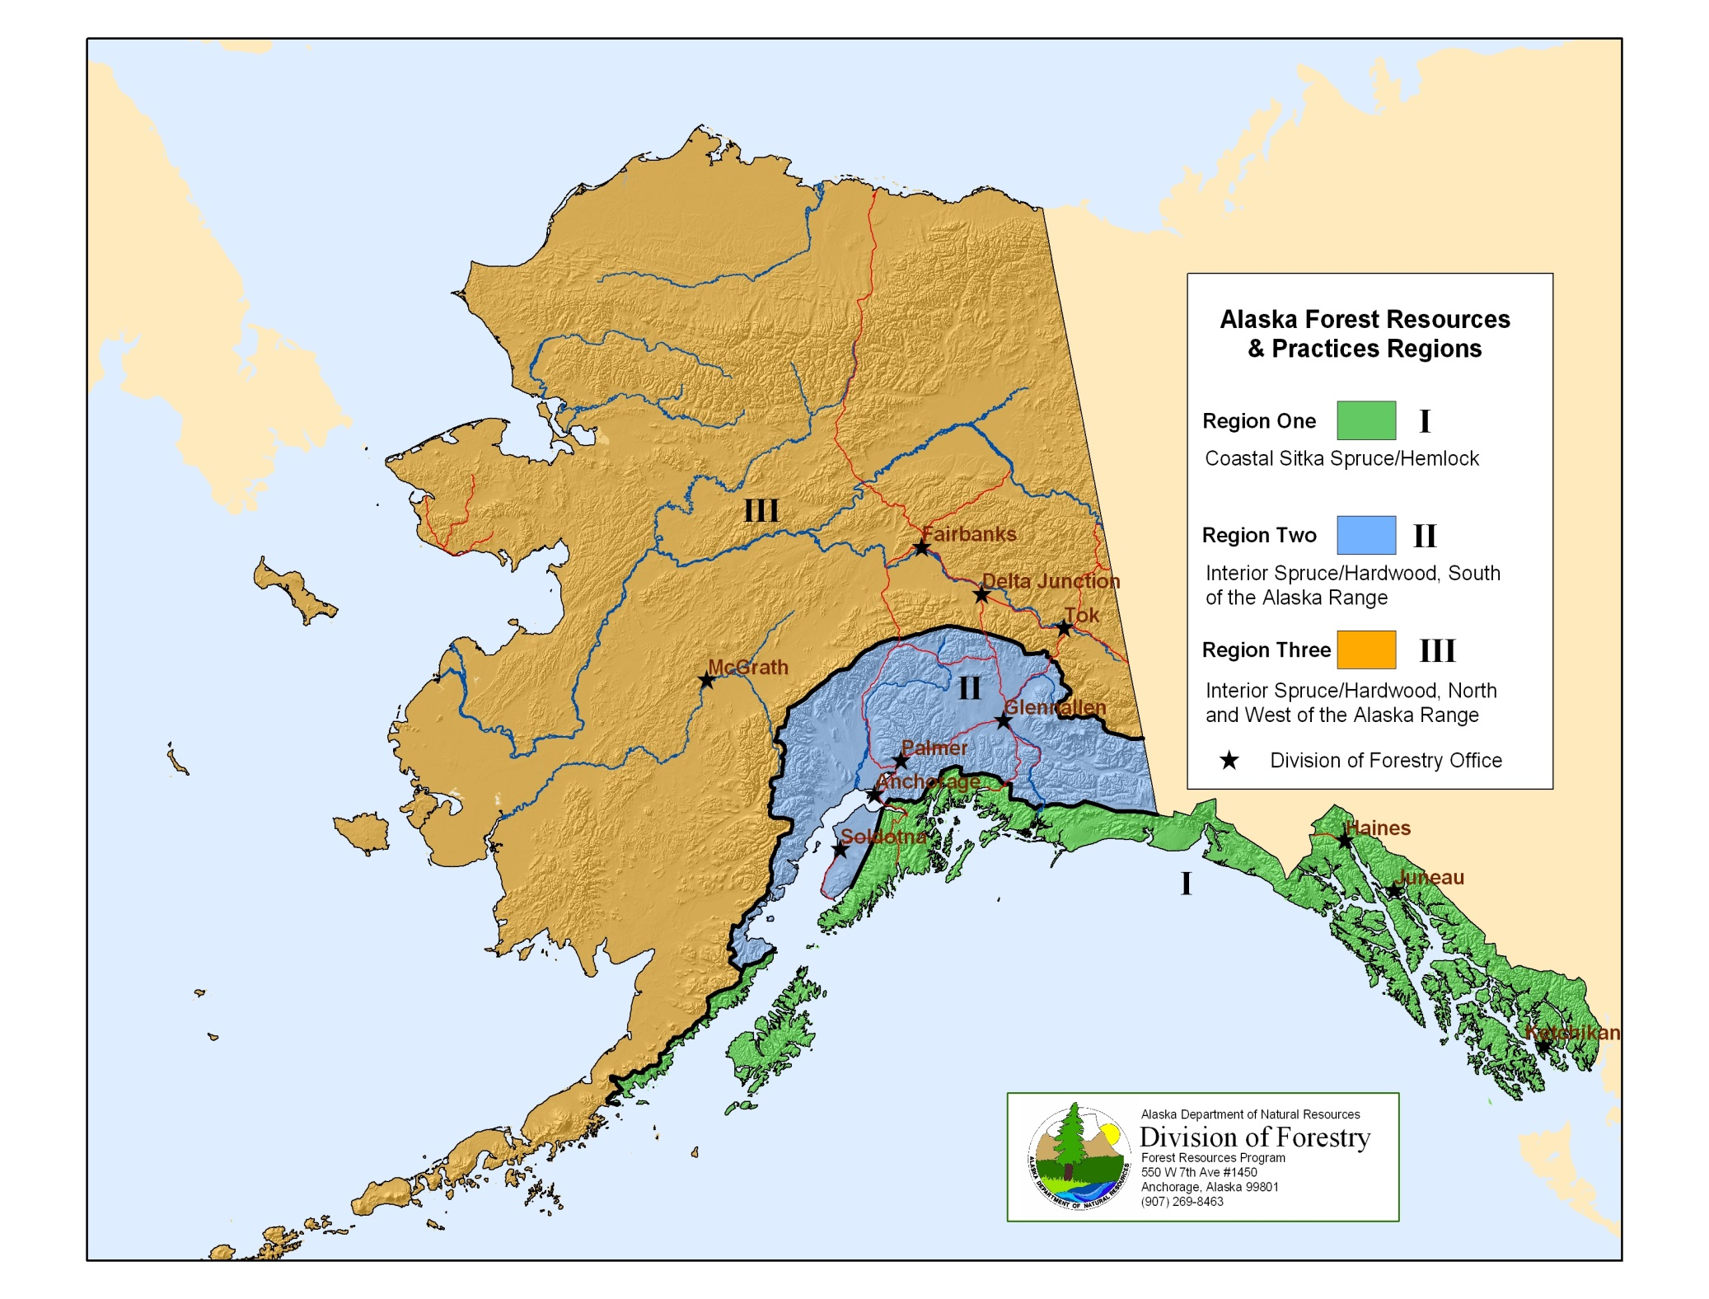

Slide 8
Definition: “Riparian area”
Region II
The area 150 feet from the shore or bank of a Type II-A or II-B water body, and 100 feet from the shore or bank of a Type II-C or II-D water body in Region II;
AS 41.17.950 (22)(B)

Slide 9
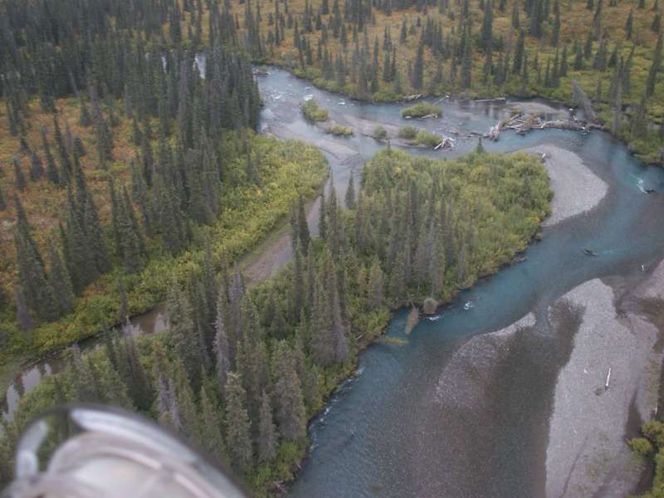
Region II water body classes: Type II-A
A non-glacial stream >50’ wide with
  anadromous or high value resident fish,
  an unconfined dynamic channel, and typically
  point bars, islands, scour planes, active or recent side channels, and areas of obvious bank erosion
AS 41.17.950 (35-36)
Type IIA - Portage Cr
Notes:
Widths are measured at ordinary high water mark

Slide 10
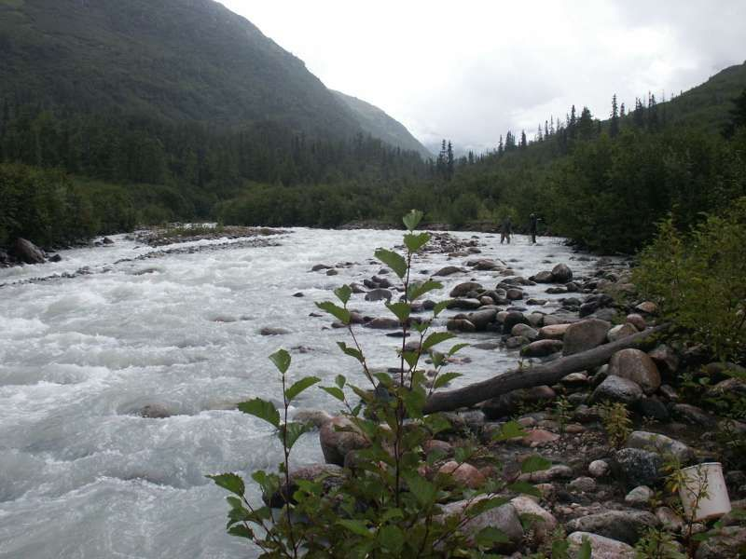
Type II-B
A glacial stream with
  anadromous or high value resident fish
  not a glacial Type II-C water body
AS 41.17.950 (35-36)
Kashwitna River

Slide 11
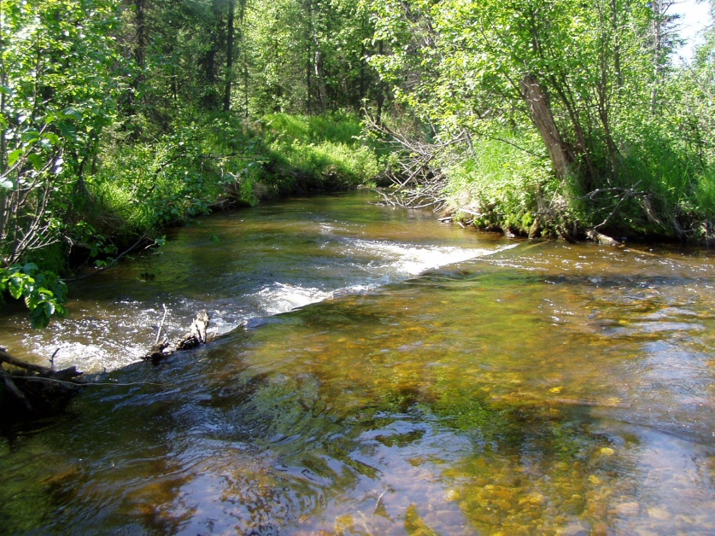
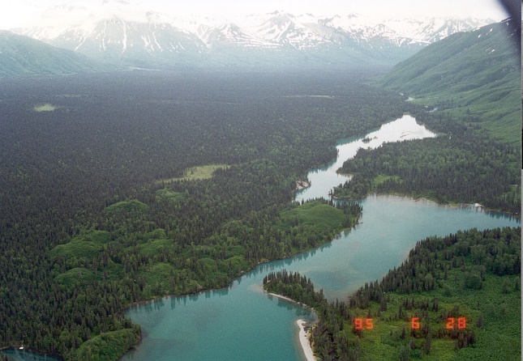
Type II-C
A water body with anadromous or high value resident fish that is
A non-glacial water body >3’ wide and <50’ wide that has an unconfined and dynamic channel;
A non-glacial water body >3’ wide that has a confined channel;
A reach of the Kenai, Kasilof, or Lake Fork Crescent rivers >3’ wide; or
A lake or pond
AS 41.17.950 (37)
Iron Cr.
Lake Fork Crescent R.
Notes:
Widths are measured at ordinary high water mark
The Kenai, Kasilof, and Lake Fork Crescent rivers are glacial rivers with many of the characteristics of a non-glacial water body (e.g., not dynamic floodplain)

Slide 12
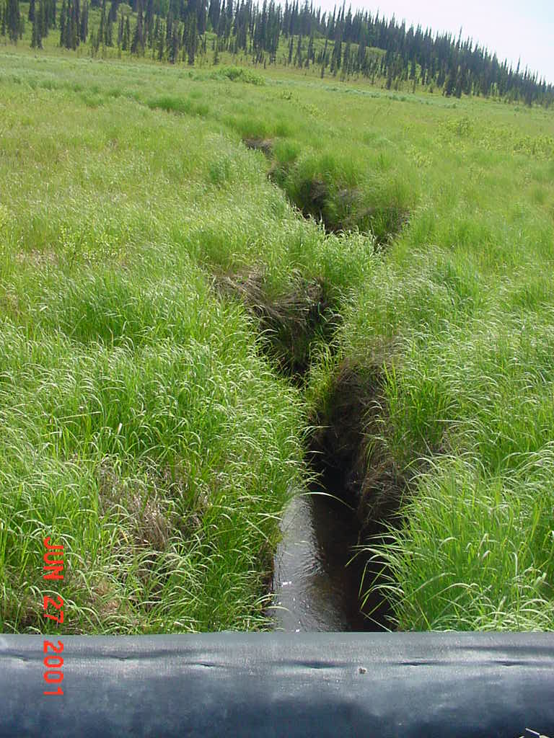
Type II-D
A non-glacial stream or a reach of the Kenai, Kasilof, or Lake Fork Crescent rivers that is <3’ wide that has anadromous or high value resident fish.
  These streams are typically unnamed, often unmapped because of their small size, and can be upstream of II-C reaches
AS 41.17.950 (38)
Chakok R. - North fork
Notes:
Widths are measured at ordinary high water mark
For more information on water body classification, see FRPA 101-D2

Slide 13
Estuarine areas
Where an estuarine area is adjacent to an anadromous or high value resident fish water body, the riparian retention area for the adjacent water body applies to the estuarine area.
Estuarine area: that area at the mouth of a Type II-A, II-B, II-C, or II-D stream where fresh and salt water mix; the landward extent of an estuary is the limit of salt-tolerant vegetation, and the seaward extent is a stream's delta at mean lower low water
AS 41.17.116 (b)(6), .118(a)(2)(F), .119(2)

Slide 14
Measurement of distances
The distance measured must be horizontal distance rather than slope distance;
Riparian areas are measured from the OHWM
The distance from a tidal zone is measured from the line of mean higher high water mark. 11 AAC 95.280, .810
66’ slope distance
66’ slope distance
66’ horizontal
66’ horizontal
Notes:
11 AAC 95.900(53) "ordinary high water mark" or "OHWM" means the mark along the bank or shore up to which the presence and action of the tidal or nontidal water are so common and usual, and so long continued in all ordinary years, as to leave a natural line impressed on the bank or shore and indicated by erosion, shelving, changes in soil characteristics, destruction of terrestrial vegetation, or other distinctive physical characteristics;

Slide 15
Riparian standards

Slide 16
Types of standards
DPO information
No-cut buffer
Special management zone
Other riparian BMPs

Slide 17
DPOs
DPOs must include:
The location and classification of known surface waters adjacent to or within harvest units
Any request for variation from riparian standards
  11 AAC 95.220(5)(A),(14),.235
Notes:
DPOs are required for non-DNR land.
On land managed by DNR, FLUPs contain the information required in a DPO.

Slide 18
Type II-A: all lands
No timber harvest of timber within 150’ of the water body;
No timber harvest along outer bends subject to erosion within 225’ of the water body or to the terrace top break, whichever is smaller
AS 41.17.116 (b)(1), .118(a)(2)(A), .119(2)

Slide 19
Type II-B: all lands
No timber harvest within 150’ of the water body;
No timber harvest along outer bends subject to erosion within 325’ of the water body or to the terrace top break, whichever is smaller
AS 41.17.116 (b)(2), .118(a)(2)(B), .119(2)

Slide 20
Augmented buffers on outer bends
The length of the augmented buffer along an outer bend subject to erosion on Type II-A or II-B waters must be equal to a distance 8 times the stream width measured on a reach between bends at a point not widened by a point bar or channel movement;
The augmented buffer must be located so that 3 stream widths are upstream and 5 stream widths are downstream of the point opposite the apex of the point bar;
AS 41.17.116 (b)(5), .118(a)(2)(E), .119(2)

Slide 21
Definition:
Outer bend subject to erosion – all lands
In Region II, a stream bend that has a cut-bank and is opposite a point bar on the inner bend.
AS 41.17.950(17)

Slide 22
Definitions:
Terrace and terrace top break
Terrace: a change in elevation greater than 10’ for a Type II-A water body or greater than 20’ for a Type II-B water body, and that has a slope >30%;
Terrace top break: the point at which the terrace slope changes to the lower angle slope of the adjacent upland; for purposes of measurement, the terrace top break is where the degree of slope is reduced by 20% or more when measured away from the stream
  AS 41.17.950(28-29)

Slide 23
Type II-A and II-B Augmented Buffer Width
Example 1: Terrace top break is beyond full width of augmented buffer – buffer extends to maximum width
Terrace top break
Augmented buffer for Type II-A waterbody
Buffer 150’
75’
175’
Augmented buffer for Type II-B waterbody

Slide 24
Type II-A and II-B Augmented Buffer Width
Example 2: Terrace top break is within augmented buffer - buffer ends at terrace top
Terrace top break
Buffer (150’)
Augmented buffer (e.g., 50’)

Slide 25
Type II-A and II-B Augmented Buffer Width
Example 3: Terrace top break within buffer – no augmented buffer
Terrace top break
No augmented buffer
Buffer 150’

Slide 26
Apex of point bar
5 stream widths downstream (1000’)
Type II-A waterbody
Augmented buffer length on outer bend subject to erosion
225’
3 stream widths upstream (600’)
150’
flow
150’
flow
No point bar
Site for measuring stream width
200’
Point bar
flow
OHWM
Edge of standard buffer
Edge of augmented buffer on outer bend subject to erosion

Slide 27
Apex of point bar
5 stream widths downstream (1000’)
Type II-B waterbody
Augmented buffer on outer bend subject to erosion
325’
3 stream widths upstream (600’)
150’
flow
150’
flow
No point bar
Site for measuring stream width
200’
Point bar
flow
OHWM
Edge of standard buffer
Edge of augmented buffer on outer bend subject to erosion

Slide 28
Type II-C: All lands
Type II-C
No timber harvest within 100’ of the water body
AS 41.17.116 (b)(3), .118(a)(2)(C), .119(2)

Slide 29
Type II-C: Public land – stream temperature
Timber harvest along a non-glacial Type II-C water body will be designed in consultation with ADF&G, to identify sites where stream temperature is a concern and where the buffer is not forested. On those sites, the timber harvest will be designed to maintain forest cover within 180’ from OHWM, where needed to retain shade and maintain stream temperature.
11 AAC 95.275(e),.260(b)
Notes:
Non-glacial Type II-C waters include:
A non-glacial water body >3’ wide and <50’ wide at OHWM that has an unconfined and dynamic channel;
A non-glacial water body >3’ wide at OHWM that has a confined channel; and
A lake or pond
These waters may be sensitive to exceedences of the water quality standards for temperature even without timber harvesting.

Slide 30
Type II-C: Public land – stream temperature, cont.
State land: During FLUP review, DOF will determine what forest cover is necessary to maintain stream temperature. DOF will give due deference to ADF&G.
Other public land: During DPO review, DOF will determine whether the forest cover proposed for retention is sufficient to maintain stream temperature. DOF will give due deference to ADF&G.
11 AAC 95.275(e),.260(b)
Notes:
See FRPA 101-A and AS 41.17.098 for more information on due deference

Slide 31
Type II-D: all lands
Type II-D
There is a 100’ riparian area
No timber harvest within 50’ of the water body
Between 50’ and 100’ from the water body, harvest may occur, but may not create flow paths or ruts that could channelize sheet flow or introduce sediment into the water body.
AS 41.17.116 (b)(4), .118(a)(2)(D), .119(2);
11 AAC 95.275(d)
Notes:
These are small streams that are particularly susceptible to impacts from erosion

Slide 32
Special management zones on State land
Along Type II-A, II-B, II-C, and II-D water bodies, timber harvest may occur between the landward extent of the riparian retention area and 300’ from the water body, consistent with the maintenance or enhancement of important wildlife habitat as determined by the commissioner with due deference to ADF&G
AS 41.17.118(a)(2)(G)
Notes:
See FRPA 101-A and AS 41.17.098 for more information on due deference

Slide 33
REGION II – Riparian Management on PRIVATE LAND
 | 50’ | 100’ | 150’ | 200’ | 250’ |  | 300’ | 325’
II-A | 150’ buffer |  |  | <75’ buffer on OBSE
II-B | 150’ buffer |  |  | <175’ buffer on outer bends subject to erosion
II-C | 100’ buffer
II-D | 50’ buffer | 50’ no sediment
Notes:
OBSE = Outer bend subject to erosion

Slide 34
REGION II – Riparian Management on OTHER PUBLIC LAND
 | 50’ | 100’ | 150’ | 200’ |  | 250’ |  | 300’ | 325’
II-A | 150’ buffer |  |  | <75’ buffer on OBSE
II-B | 150’ buffer |  |  | <175’ buffer on outer bends subject to erosion
II-C | 100’ buffer |  | 80’ SMZ for temp.
II-D | 50’ buffer | 50’ no sediment
Notes:
SMZ = Special management zone
OBSE = Outer bend subject to erosion

Slide 35
REGION II – Riparian Management on STATE LAND
 | 50’ | 100’ | 150’ | 200’ |  | 250’ |  | 300’ | 325’
II-A | 150’ buffer |  |  | <75’ buffer on OBSE
 |  |  |  | 150’ SMZ
II-B | 150’ buffer |  |  | <175’ buffer on outer bends subj. erosion
 |  |  |  | 150’ SMZ
II-C | 100’ buffer |  | 200’ SMZ for wildlife habitat
 |  |  | 80’ SMZ for temp.
II-D | 50’ buffer | 250’ SMZ
Notes:
SMZ = Special management zone
OBSE = Outer bend subject to erosion

Slide 36
New Fish-bearing Streams
An operator shall promptly inform DOF if a previously unknown fish water body is found within an operating area.
Operations in the vicinity of a newly discovered or reclassified water body that has standing timber remaining in the riparian area must comply with the riparian standards with respect to the remaining timber.
11 AAC 95.230 (d), .265(e)

Slide 37
Planning on state land
DNR area and management plans (adopted under AS 38.04.065) may impose additional riparian protection standards for timber harvest operations
AS 41.17.118(b)
Copper River Basin AP
Hatcher Pass MP
Kenai AP
Knik MP
Southeast Susitna AP
Susitna Matanuska AP
Turnagain Arm MP
Notes:
AP = Area Plan; MP = Management Plan

Slide 38
Allowed uses in riparian areas

Slide 39
DPO notice required
Operations allowed within riparian must be identified in the DPO
  Exception: felling and removing hazard trees along roadways as required by state or federal law is allowed and does not need to be identified in the DPO
  11 AAC 95.275(b-c)

Slide 40
Allowed uses: roads & crossings
Road building and associated activities where access is needed to a water body crossing, or where there is no feasible alternative. A stream crossing or a road in any riparian area must be identified in a DPO and be designed and located to minimize significant adverse effects on fish habitat and on water quality. 11 AAC 95.275(a)(1), .285(b)
A water body crossing built in accordance with the bridge standards and identified in a DPO. 11 AAC 95.275(a)(2),.300

Slide 41
Allowed uses: materials, blocks
Locating material extraction sites in braided, glacial floodplains in accordance with the regulations for material extraction and disposal sites (11 AAC 95.325); sites must be identified in a DPO.
Installing blocks, or similar devices on a tree required for retention under this chapter if the device is installed to minimize damage to the tree.
11 AAC 95.275(a)(4),(5)

Slide 42
Allowed uses: lifts, rigging, yarding
The use, as lift trees or tail holds, of trees required for retention under this chapter
Hanging of rigging through the riparian area if necessary to be consistent with operator safety requirements and to have a clear line of sight and working area for the rigging
On state and other public land, yarding corridors and other logging methods that do not cause a significant adverse impact to the riparian habitat
11 AAC 95.275(a)(6)(8)

Slide 43
Other riparian BMPs
Note: There are additional BMPs in the following sections. This presentation includes only those subsections specific to riparian areas.

Slide 44
Felling and bucking
If feasible, an operator may not fell a tree into a riparian timber retention area.
    See also the purple book section on 11 AAC 95.355(e)(1) for compliance monitoring procedures
11AAC 95.355(e)

Slide 45
Marking riparian areas
Where a riparian timber retention area abuts or is within a harvest unit, mark the limits of the riparian retention area before harvest begins.
Each marking must be visible from adjacent markings;
Marking with flagging, painting, or another identification system.
11AAC 95.270 (a),(b)

Slide 46
Marking riparian areas, cont.
Mark while the area is free of snow cover that would prevent accuracy, unless a water body is large, incised, or otherwise identifiable when under snow cover.
A tree on a riparian retention area boundary is in the retention area if >50% of the diameter of the bole of the tree is in the riparian retention area as measured at 4-1/2’ feet above the ground or at the top of the root collar, whichever is higher.
11AAC95.270 (c),(d)

Slide 47
Blasting
Any discharge of explosives in riparian areas in Region II requires a variation.
11 AAC 95.235, .335(a)(2)

Slide 48
Bank integrity
In a riparian area, where feasible and necessary, leave high stumps to prevent felled and bucked timber from entering surface waters.
    See also the purple book section on 11 AAC 95.350(c) for objectives and compliance monitoring procedures
11 AAC 95.350 (c)

Slide 49
Cable yarding
When yarding in or near a riparian area, an operator shall make an effort to minimize soil disturbance and to prevent logs from rolling into surface waters or the riparian area.
    See also the purple book section on 11 AAC 95.360(c)(4) for objectives and compliance monitoring procedures
11 AAC 95.360(c)(4)

Slide 50
Cable yarding
Partially or fully suspend logs when yarding.
Select landings to minimize side-hill yarding near the stream or riparian area (e.g., position landings so logs are yarded uphill and away from the stream as much as possible).
Do not locate landings near an incised stream, especially when yarding downhill. A high lead system has limited suspension capabilities.
Notes:
See also the purple book section on 11 AAC 95.360(c)(4) for objectives and compliance monitoring procedures

Slide 51
Tracked and wheeled systems
In riparian areas:
  Minimize the number of skidding routes
  Consistent with good safety practices, log skidding must minimize damage to retained trees, stumps, root systems, understory vegeta­tion, and soils; and
  Use one-end suspension of logs.
    11 AAC 95.365(b)
Notes:
See also the purple book section on 11 AAC 95.350(c) for objectives and compliance monitoring procedures

Slide 52
Slash burning
When slash is disposed of by burning, protect a riparian area from fire, and burn under weather conditions that minimize the chance of air quality degradation and fire escape.
11 AAC 95.370(b)

Slide 53
Variations

Slide 54
Variations
A forest landowner, timber owner, or operator may propose a variation to allow harvesting of specific trees within a riparian area.
DOF shall agree to the proposed variation if it determines that the harm intended to be avoided by the requirement
  is not likely to occur because of site‑specific circumstances, and
  is not likely to cause significant harm to fish habitat or water quality
  AS 41.17.087
AS 41.17.087

Slide 55
Variations: appeals & due deference
If DOF does not agree to the proposed variation, the owner or operator may appeal to the DNR commissioner. Appellants must conform to the requirement while the appeal is pending.
DNR shall give due deference to ADF&G and DEC for variation determinations
AS 41.17.087
Notes:
See FRPA 101-A and AS 41.17.098 for more information on due deference

Slide 56
Variations: conditions
DOF will consider the impact of the variation harvest on non-merchantable trees within the riparian retention area, and may condition and document the variation authorization to protect non-merchantable trees that are important to maintain fish habitat and water quality.
11 AAC 95.235(d)

Slide 57
Region III variations: DPO
Include the following information in DPO:
A map at 1:12,000 scale or finer that clearly shows the anadromous or high value resident fish water body and the approximate location of the requested trees;
The length of reach along which the variation trees are requested;
The surface water body classification type and average channel width of the reach along which the variation trees are requested;
A description of the species and the DBH range of the trees requested for harvesting;
11 AAC 95.220(14)(B)

Slide 58
Region II variation: DPO, cont.
The minimum distance from OHWM to the proposed variation harvest; and
The percentage of trees >9” DBH within the reach for which any variation is sought that the operator is requesting to harvest, and that were harvested under a prior variation request, if any.
11 AAC 95.220(14)(B)
Notes:
OHWM = Ordinary high water mark

Slide 59
QUESTIONS?

Slide 60
Addenda
Key to classification system
Examples of stream types

Slide 61
Key to Region II waterbody classification
Does the waterbody have anadromous or high value resident fish at least seasonally?
Other surface waters
No
Yes
Type II-D: Non-glacial waters or reaches <3’ wide of kenai, Kasilof, or Crescent R.
Is it a glacial stream other than the Kenai, Kasilof, or Crescent R.?
No
Is it >3’ wide at OHWM?
No
Type II-A: Non-glacial waters >50’ wide with unconfined channels
Yes
Yes
No
Is it >50’ wide at OHWM with a dynamic, unconfined channel, & features incl. islands, point bars, and obvious areas of erosion?
Type II-C: Large relatively stable channels incl. confined non-glacial channels >3’ wide, unconfined non-glacial channels >3’ and <50’ wide, lakes, and the Kenai, Kasilof, and Crescent rivers
Type II-B: Other glacial waters
Yes

Slide 62
Type II-A examples
Lower reaches of:
Willow Cr. (Mat-Su)
Montana Cr. (Mat-Su)
Clear Cr. (Mat-Su)
Peters Cr. (Mat-Su)
Chuitna R. (W Cook Inlet)
Theodore R. (WCI)
Lewis R. (WCI)
Gulkana R. (Copper R.)
E.Fk. Chistochina (Copper R)
Hanagita R. (Copper R.)
Anchor R. (Kenai)
Deep Cr. (Kenai)
Ninilchik R. (Kenai)

Slide 63
Type II-B examples
Chakachamna R. (W. Cook Inlet)
Beluga R. (WCI)
North Fork Crescent R.
Crescent R. below N. Fk/Lake Fk confl. (WCI)
Chichantna R. (WCI)
Kahiltna R. (Mat-Su)
Susitna R. (Mat-Su)
Matanuska R. (Mat-Su)
Knik R. (Mat-Su)
Kashwitna R. (Mat-Su)
Sheep Cr. (Mat-Su)
Yentna R. (Mat-Su)
Skwentna R. (Mat-Su)
Chulitna R. (Mat-Su)
Talkeetna R. (Mat-Su)
Klutina R. (Copper R.)
Copper R. (Copper R.)
Tazlina R. (Copper R.)
Nelchina R. (Copper R.)
Chistochina R. (Copper R.)
Gakona R. (Copper R.)
Chitina R. (Copper R.)
Slana R. (Copper R.)

Slide 64
Type II-C examples
Fish Cr. (Mat-Su)
Lake Cr. (Mat-Su)
Deshka R. (Mat-Su)
Little Susitna (Mat-Su)
Alexander Cr. (Mat-Su)
Chijuk Cr. (Mat-Su)
Trapper Cr. (Mat-Su)
Goose Cr. (Mat-Su)
upper Anchor R. (Kenai)
Moose R. (Kenai)
Crooked Cr. (Kenai)
Swanson R. (Kenai)
Lower Stariski Cr. (Kenai)
Kasilof R. (Kenai)
Tustumena Lk. (Kenai)
Kenai R. & Lk. (Kenai)
Crescent R. (W. Side CI)
Tazlina L. (Copper R.)
Mentasta Creek (Copper R.)
Indian Creek (Copper R.)
Tulsona Creek (Copper R.)
Indian Creek (Copper R.)
Sinona Creek (Copper R.)
Ahtell Creek (Copper R.)
Chistochina R. (Copper R.)
Upper reaches of many II-A streams are also
classified II-C

Slide 65
Type II-D examples
These streams are typically unnamed and often unmapped because of their small size ; can be upstream of II-C reaches

